Slide 1


TATA Data Visualization

Slide 2

Introduction
Good day, everyone. In this presentation, we’ll delve into the company’s sales performance during the years 2010 and 2011. I’m grateful for the opportunity to analyze this data and extract valuable insights regarding the store’s overall performance.

Slide 3

Process
All the necessary steps were taken to ensure that the analysis is accurate and correct.
I cleaned up the data that was provided to me by removing all the negative values in the unit price and quantity column and also filtered the data as required for all the visualization.

Slide 4
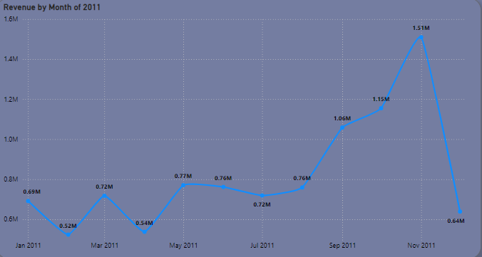
Revenue by Month 2011
During the initial 8 months, our monthly revenues remained relatively stable, with minor fluctuations. On average, we generated $685,000 in revenue per month.
However, starting in September, we experienced a significant boost in revenue. In November, our revenue peaked at $1.15 million.
Notably, there was an average increase of 21.18% in revenue from August to November. This trend highlights how seasonality impacts retail store sales.

Slide 5
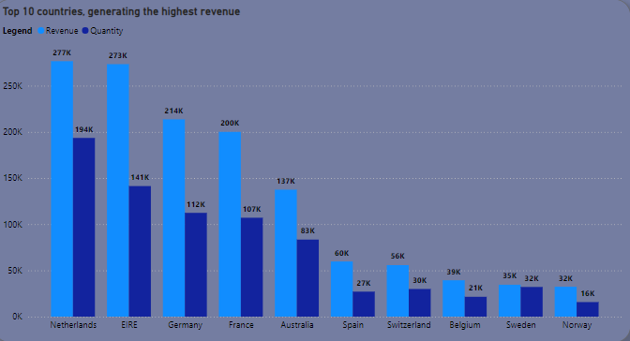
Top 10 Countries by Revenue and their Quantity
The chart represents the top 10 countries in terms of revenue and the quantities of goods sold, excluding the United Kingdom.
Notably, there is a strong correlation between revenue and quantity, indicating a high purchasing power in these countries. To maximize our potential, management should focus on targeted marketing strategies in these regions.

Slide 6
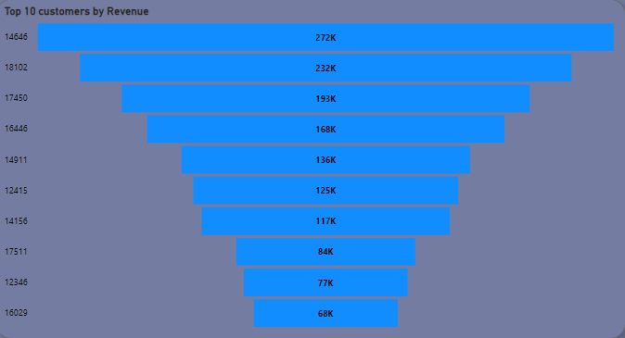
Top 10 Customers by Revenue
This charts show that there is no major difference between the top 10 customers in terms of revenue generated.
The average difference is revenue between the top 10 customers in 15.8%.
The company can aim to strengthen the relationship with these customers to increase customer loyalty and retention and ultimately drive more sales an revenue for the company.

Slide 7
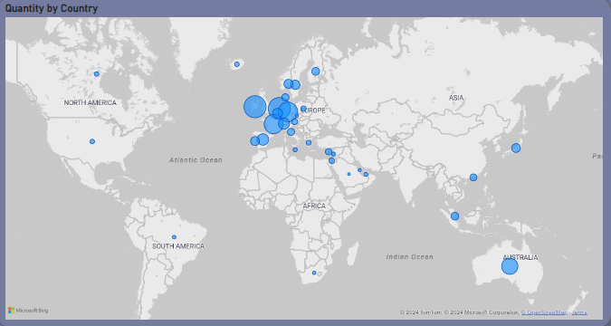
Revenue by Countries
The map chart concludes by comparing the places that have produced the greatest revenue to those that have not.
The map also reveals that the majority of sales occur only in the European zone , with a small number in American region.
Along with Russia, there is no market for the items in Africa or Asia.
The company can concentrate on the European market more and dive deeper into countries in the region to come up with strategies that will maximize sales from each country in the region alongside Australia and Japan

Slide 8

Recommendations
Seasonal Strategies: The company should focus on stocking and promoting seasonal products to capitalize on increased demand during peak periods.
Product Analysis: Conduct a detailed analysis of products that perform well during low sales months. Use this information to develop targeted marketing strategies for these items.
Regional Insights: Explore product-specific revenue data for each region. This will guide customized marketing approaches based on regional preferences.
Customer Incentives: Strengthen relationships with top revenue-generating customers by offering incentives or personalized experiences.
European Expansion: Prioritize strategies to enhance market positioning in the European market, which holds significant growth potential

